Slide 1
Introduction to data warehousing
MTN.BI.07
Oracle Data Access and Optimizer
Elias Nema
Lead Software Engineer
Elias_Nema@epam.com

Slide 2
Agenda
Overview of the Optimizer
Access Methods: Table Scans, Index Scans, Cluster Scans

Slide 3
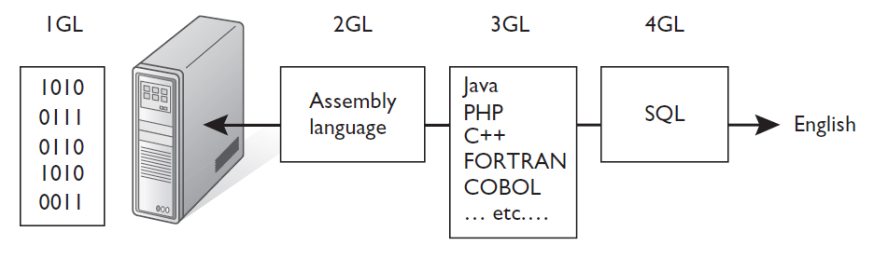
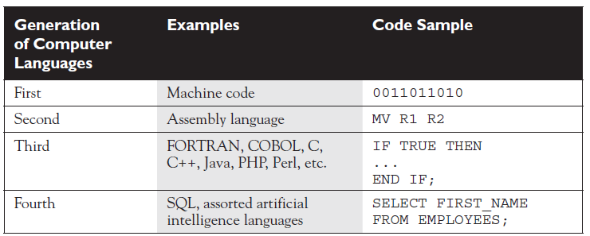
But first, a step back

Slide 4
SQL
The general idea with each generational step away from machine language is to try to get closer to the point where plain spoken human language will be sufficient to program a computer.
Wide variety of tools and languages from which to choose when developing an application, there’s only one choice when it comes to database interaction, and that’s SQL.

Slide 5

Advertisement
The result: SQL has never gone “out of style” as many other languages have. Demand for other languages ebbs and wanes, but the demand for skilled SQL professionals has been persistently high ever since the early 1980s.

Slide 6
Oracle optimizer

Slide 7
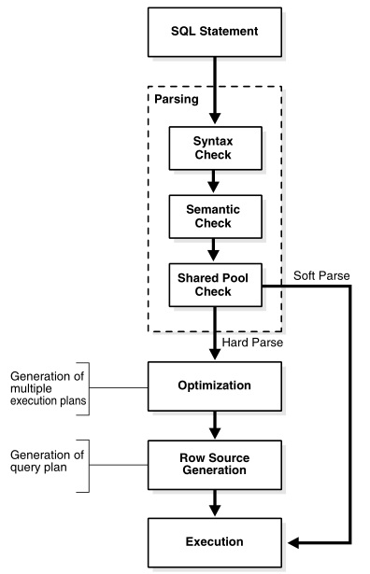
What happens when a SQL statement is issued?
Data Dictionary
Optimizer

Slide 8

As Always, a Bit of History
At the beginning, there were rules
1979-1991

Slide 9
Rule-Based Optimization
Rule Based Optimizer (RBO) is a heuristic based Optimizer
Uses a ranked list of access paths (rules)
About 20 rules
Lower ranked access paths assumed to operate more efficiently
Plans chosen based on access paths available and their rank
If multiple access paths existed path with the lowest rank chosen
Only very simple physical optimizations done automatically
OR Expansion: multiple OR predicates rewritten as UNION ALL

Slide 10
And Then Cost Appeared
Database features become more and more complex
Partitioning
Parallel execution
Having only one plan per statement regardless of the objects size or structure was no longer the best approach
Optimizer had no chance but to evolve

Slide 11
New Cost-Based Approach
Multiple execution plans generated for a statement
Estimated cost is computed for each plan
Optimizer selects the plan with the lowest estimated cost

Slide 12
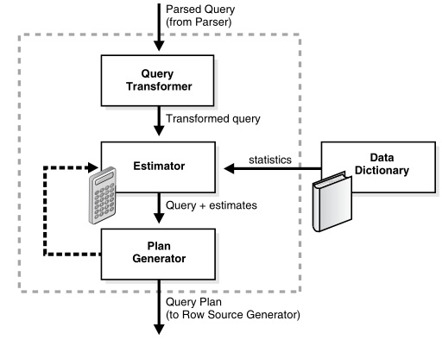
Overview of the Optimizer
Optimizer steps:
The optimizer receives the parsed query and generates a set of potential plans for the SQL statement based on available access paths and hints.
The optimizer estimates the cost of each plan based on statistics in the data dictionary (cost is proportional to the expected resource use).
The optimizer compares the costs of plans and chooses the lowest-cost plan to pass to the row source generator.

Slide 13
Query Transformer
Each query portion of a statement is called a query block. The input to the query transformer is a parsed query, which is represented by a set of query blocks.
The query form determines how query blocks are interrelated. The transformer determines whether it is advantageous to rewrite the original SQL statement into a semantically equivalent SQL statement that can be processed more efficiently.
The query transformer employs several query transformation techniques, including the following:
View Merging
OR Expansion
Subquery Unnesting
Star Transformations

Slide 14
Estimator
Selectivity. This measure represents a fraction of rows from a row set. The selectivity is tied to a query predicate, such as last_name='Smith', or a combination of predicates.
Cardinality. This measure represents the number of rows in a row set.
Cost. This measure represents units of work or resource used. The query optimizer uses disk I/O, CPU usage, and memory usage as units of work.

Slide 15
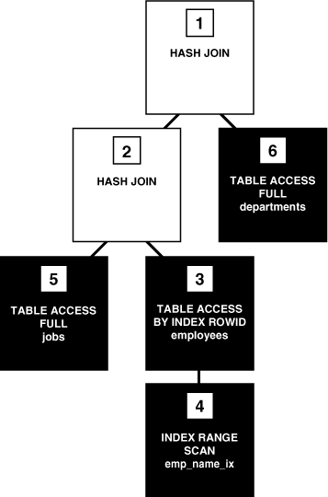
Row Source Tree

Slide 16
SQL Processing
Separating the pieces of a SQL statement into a data structures
Choosing the most efficient means of executing a SQL statement.
Optimizer
Receives the optimal execution plan from the optimizer and produces an iterative plan in form of row source tree
SQL engine executes each row source in the tree produced by the row source generator

Slide 17
SQL Parsing
When an application issues a SQL statement, the application makes a parse call to the database to prepare the statement for execution. The parse call opens or creates a cursor, which is a handle for the session-specific private SQL area that holds a parsed SQL statement and other processing information. The cursor and private SQL area are in the program global area (PGA).
During the parse call, the database performs the following checks:
Syntax Check
Semantic Check
Shared Pool Check

Slide 18
Execution More Detailed
Create cursor (a cursor exists for every statement run)
Parse statement
a hard parse:
Translate the statement and verify the syntax is valid
Check the data dictionary and make sure the referenced objects exist
Get parsing locks on all required objects so the definitions don't change
Check and make sure the executing user has privileges to the objects
Figure out the best way (execution plan) to perform the request
Load all this into a shared SQL area so others won't have to get this far
Describe results and define output (Queries only) used to determine and define what the result set looks like (datatypes, etc)
Bind variables
Parallelize statement (optional)
Run
Fetch rows (Queries only)
Close cursor

Slide 19
Access methods

Slide 20
Oracle Data Access Methods
Full table scans. Reads all rows from a table and filters out those that do not meet the selection criteria. The database sequentially scans all data blocks in the segment under the high water mark (HWM).
Rowid scans. The database first obtains the rowids of the selected rows, either from the statement WHERE clause or through an index scan, and then locates each selected row based on its rowid.
Index scans. Searches an index for the indexed column values accessed by the SQL statement (if the statement accesses only columns of the index, then Oracle reads values directly from the index).

Slide 21
But before diving in
Starting with Oracle9i, there are two methods for managing space in segments:
Manual Segment Space Management (FREELISTS, FREELIST GROUPS, PCTUSED, and others)
Automatic Segment Space Management (ASSM): (PCTFREE)

Slide 22
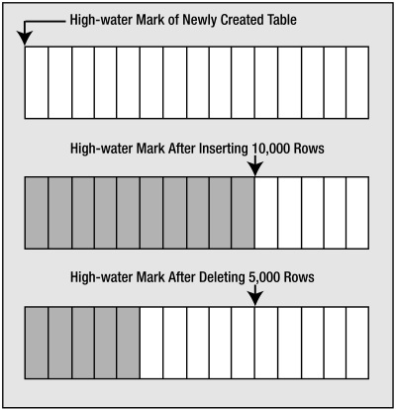
High Water Mark
The HWM is relevant since Oracle will scan all blocks under the HWM, even when they contain no data, during a full scan.
Notes:
So, when you delete the information, the block is still "a block", it is just a block that once had active rows - but no longer does.
And when you full scan the table - we have to read all blocks that at any time contained data - because - they could contain data now. We won't know what is there until we read it.
Suppose you deleted all but ONE row - we have to look in every block (unless of course we use an index) to see if that row is on a given block.
As data is placed into the table over time and more blocks get used, the HWM rises. If we delete some (or even all) of the rows in the table, we might have many blocks that no longer contain data, but they are still under the HWM, and they will remain under the HWM until the object is rebuilt, truncated, or shrunk.

Slide 23
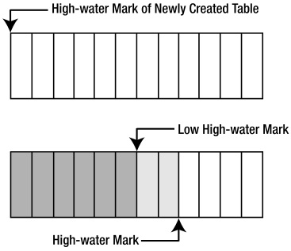
Low High Water Mark
In an ASSM tablespace there is an HWM and a low HWM.
With ASSM Oracle doesn’t format all of the blocks immediately—they are only formatted and made safe to read upon their first actual use.
The data is inserted in any of the blocks between the low high water mark and the high water mark, so many of the blocks in this area might not be formatted.

Slide 24
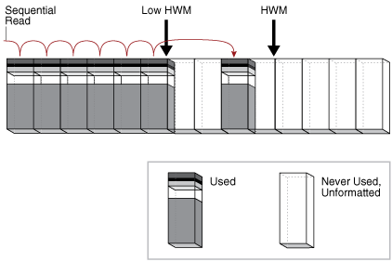
Full Table Scan

Slide 25
What Affects Full Scan Access Methods
Percentage of retrieved rows & data distribution. How data is distributed between the data blocks may lead to a conclusion that it makes sense to do a full scan even when the percentage of rows is quite small.
Throwaway rows (CPU overhead). Consider number of blocks that will need to be read as well as how many rows will end up in the final result set.
Multiblock reads. A full scan operation makes multiblock reads. This means that a single IO call will request several blocks instead of just one.
High Water Mark. When a full scan operation occurs, all blocks up to the highwater mark will be read in and scanned, even if they are empty. This means that many blocks that don’t need to be read because they are empty will still be read. The overhead of reading additional empty blocks can mean performance takes a significant hit.

Slide 26
Table Access by Rowid
A rowid is an internal representation of the storage location of data. The rowid of a row specifies the data file and data block containing the row and the location of the row in that block. Locating a row by specifying its rowid is the fastest way to retrieve a single row because it specifies the exact location of the row in the database.
The following steps are performed:
Obtains the rowids of the selected rows, either from the statement WHERE clause or through an index scan of one or more indexes. Table access may be needed for columns in the statement not present in the index.
Locates each selected row in the table based on its rowid.

Slide 27
Index Scan Access Methods
Index Unique Scan
An index unique scan returns at most 1 rowid.
Index Range Scan
An index range scan is an ordered scan of an index that has the following characteristics:
One or more leading columns of an index are specified in conditions.
0, 1, or more values are possible for an index key.
Full Index Scan
Reads the entire index in order. A full scan can eliminate sorting because the data is ordered by index key.
Fast Full Index Scan
The database accesses the data in the index itself without accessing the table, and the database reads the index blocks in no particular order.
Index Skip Scan
The database accesses the data in the index itself without accessing the table, and the database reads the index blocks in no particular order.

Slide 28
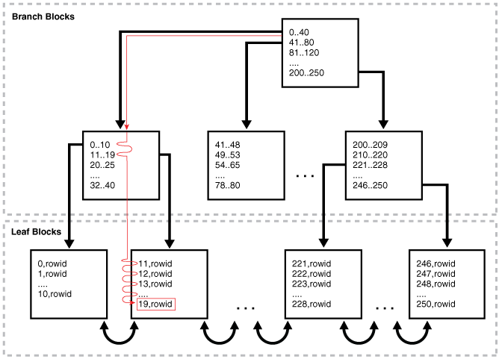
Index Unique Scan

Slide 29
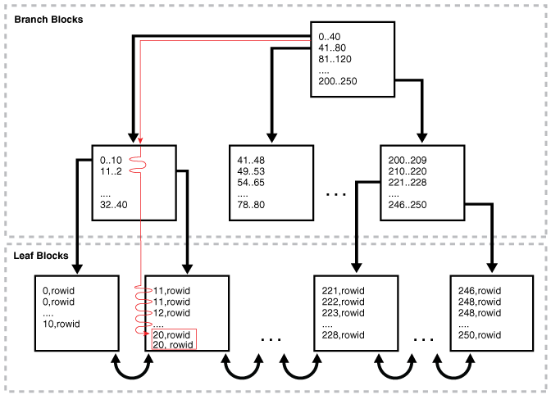
Index Range Scan

Slide 30
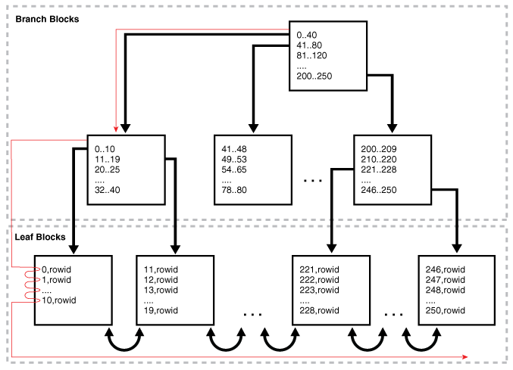
Index Full Scan

Slide 31
Oracle Data Access and Optimizer
Elias Nema
Lead Software Engineer
Elias_Nema@epam.com

